Slide 1
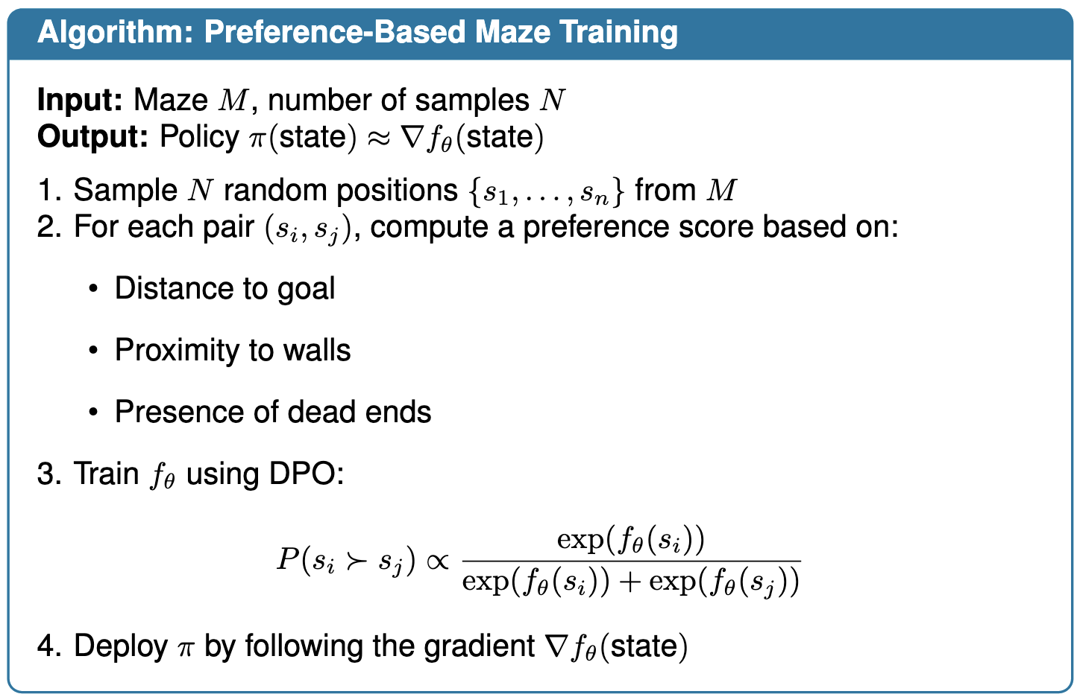
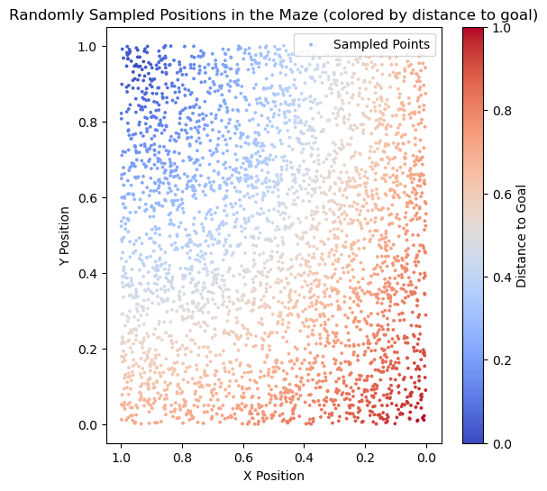
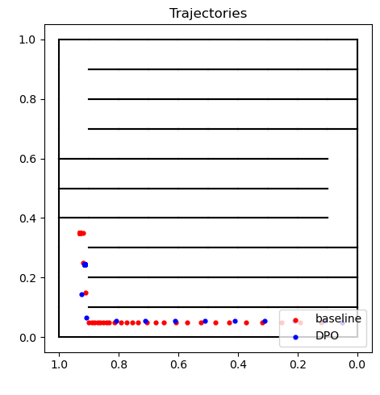
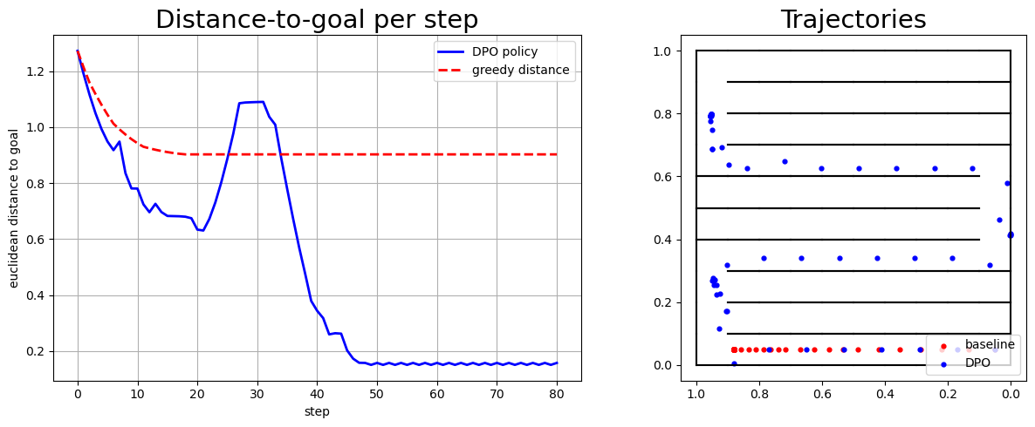
No reward? No problem: Training Maze Agents with Preferences
Giovanni Filomeno
Supervisor: Vihang Patil
Motivation:
Defining reward functions for complex navigation tasks is difficult and often misleading. Preference-based learning as an alternative is explored, highlighting its failure modes and improvements.
Challenge:
Can DPO learn navigation behavior in maze environments? What are its limits, and how can we overcome them?
Key Contributions:
A custom maze environment for testing preference-based methods
Identification of a specific failure mode in DPO when preference signals are misaligned
A scoring function and preference shaping method to recover performance in those cases
Experimental Setup & Key Insights: m
Environment: A custom 2D maze environment was developed with winding “S-shaped” corridors to expose weaknesses in naïve and greedy strategies.
Point Generation: Thousands of random states were sampled within the maze to build a diverse dataset for learning preferences.
Preference Function: Pairwise preference scores were computed using a handcrafted metric combining distance to goal, proximity to walls, presence of dead ends, and actual path length.
Learning via DPO: A neural network was trained to model preferences by assigning higher scores to better states, effectively shaping a reward-free value function through ranking loss.
Sensitivity Analysis (Future Work): The final policy was highly sensitive to the choice of scoring function. Minor changes in dead-end penalties or path length weights produced drastically different behaviors, highlighting the importance of careful preference design.
Introduction:
In many real-world settings, designing a dense and reliable reward function is impractical.
Preference-based learning offers an alternative: agents learn which behaviors are better via pairwise comparisons.
Direct Preference Optimization (DPO) enables scalable learning from such comparisons, without needing explicit rewards.
However, DPO can fail in sparse or deceptive environments.
This failure mode has been studied in a custom maze setting and propose a scoring strategy to make preference-based learning effective even without hand-crafted rewards.
Calibration of preference: poorly calibrated score leads to fail
Results: DPO can escape from Maze

